Slide 1
Azure Infrastructure Workshop
Brad Allen
Notes:
http://windowsitpro.com/windows-10/new-windows-10-keyboard-shortcuts
WIN+CTRL+D: Create new virtual desktop
WIN+CTRL+F4: Close current virtual desktop; all applications will be moved to another virtual desktop
WIN+CTRL+LEFT or RIGHT: Switch virtual desktop
WIN+TAB: view them all

Slide 2
Agenda
Types of cloud and cloud service
Azure Fundamentals
VMs with Azure IaaS
Using Azure Storage
Networking in Azure
Connecting Azure to On-premises
Complementary Solutions

Slide 3

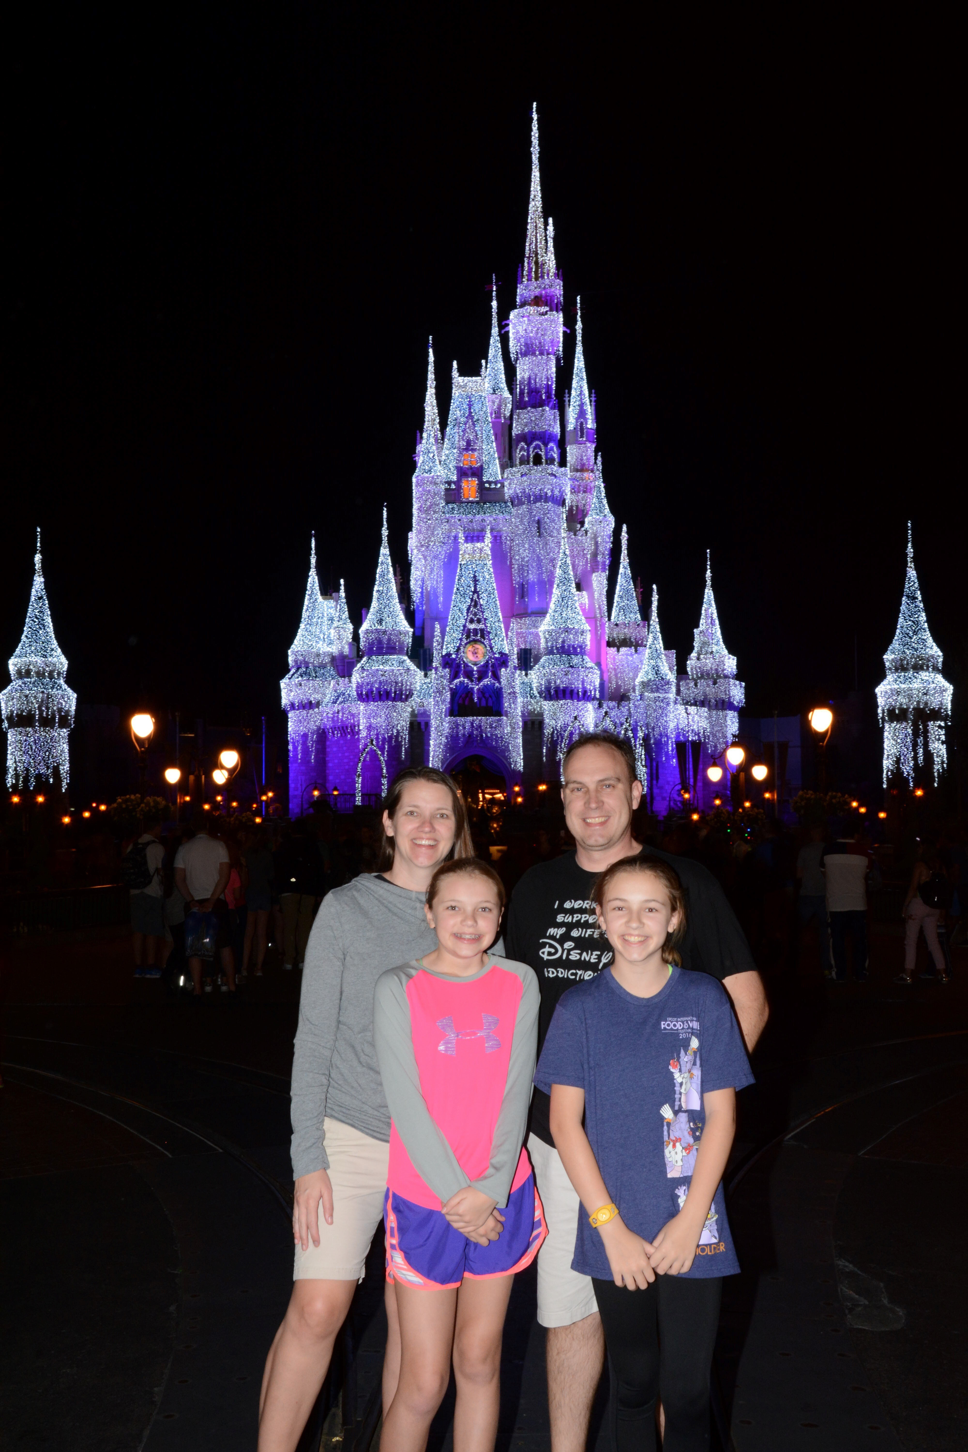
About Brad
Wife Emily, Alexis 12, Julia 10
Georgia Native – 4 generations
“Renaissance Man”
Been a “Softie” for 11 years
Nicknamed “Cap” – Major Captain America fan
Microbiologist by school, tech nerd by hobby
Disney lover and annual passholder
Been in the Azure business 4 years
Infrastructure background with just enough Visual Studio to be dangerous

Slide 4
Types of Cloud and Cloud Service

Slide 5
Cloud Services
Many types of Cloud Service
These cloud services can be hosted:
Within an organizations own infrastructure, Private Cloud, with full access to all aspects
From an external party accessed over the Internet and made available to general public in a multi-tenant deployment, Public Cloud, e.g. Microsoft Azure, Amazon Web Services. Access only to specific aspects based on the service
A combination of clouds brings a Hybrid Cloud solution
Notes:
Government common use community cloud

Slide 6
Types of “as a Service”
On-Premises
Infrastructure
as a Service
Platform as a Service
Software as a Service
Applications
Applications
You manage
Applications
Applications
Data
You manage
Data
Data
Data
Runtime
Runtime
Runtime
Runtime
You manage
Middleware
Middleware
Middleware
Middleware
Vendor Manages
Vendor Manages
O/S
O/S
O/S
O/S
Virtualization
Virtualization
Vendor Manages
Virtualization
Virtualization
Servers
Servers
Servers
Servers
Storage
Storage
Storage
Storage
Networking
Networking
Networking
Networking
Notes:
You can offer these on-premise
Goal would be SaaS for everything but realistically will be many things not available as SaaS (Office 365) so if possible PaaS but again many not available to think IaaS and then maybe overtime move to PaaS and SaaS. IIS in VM could move to web sites. SQL in a VM move to Azure Database etc etc
Desktop aaS
Database aaS
Minecraft as example of IaaS vs SaaS. Server in a VM vs Realms. Think of different aspects
Update of OS
app update
Backup of worlds
performance
no mods though with Realms so you lose

Slide 7
When to use Public Cloud Solutions
Different organizations have different priorities and can operate services/datacenters at different price points
Requirements for resiliency that may not be possible on-premises because of infrastructure constraints
Key differentiator is Public Cloud solutions charge you based on consumption
If I consume 100 TB of storage I pay for 100 TB and not the 500 TB I may need in the future
If a virtual machine runs for 12 hours a month I pay for the 12 hours it is running only
The fact you pay only when its needed means Public Cloud fits a number of key scenarios perfectly
Agility for service delivery
Notes:
People see provisioning/deprovisioning as a benefit even though could be enabled on-premises

Slide 8
Key Scenarios
Notes:
Pizza is an example of predictable bursting. Consider Friday night when pizza restaurants are 4 times busier than any other time of the week. Rest of the week 75% of hardware unused. Then superbowl for 5 hours pizza restaurants 4 times busier than Friday night. All year other then 5 hours nearly all hardware idle.
Extrapolate
Think “failing fast”. For a startup company it needs to succeed or fail fast to avoid wasted money. When looking for investment being able to use public cloud and only pay for what it uses instead of having to heavily invest in large amounts of infrastrure. When looking for funding the public cloud s can help secure and give investors confidence.
On and off could be a tax office for example..
Can also use public cloud to supplement on-premise in a hybrid mode.

Slide 9
Example Usage Scenarios
Test and development
For final testing the environment should match production but most aspects are independent of hypervisor
Disaster Recovery
DMZ scenarios
Special projects and new applications
Lift & shift of tier 1 applications
Some organizations are cloud first and want to get out of the datacenter business
Notes:
Test/dev has high “churn” so it can be desirable to not run that on-premises just to avoid the associated work
International

Slide 10
Azure Fundamentals

Slide 11























































Azure Services
Platform Services
Security & Management
Services Compute
Web and Mobile
Data
Hybrid
Operations
Cloud
Services
Service
Fabric
Web Apps
API Apps
Portal
SQL
Database
Data
Warehouse
DocumentDB
Azure AD
Health Monitoring
Azure Active
Directory
Batch
RemoteApp
AD Privileged
Identity
Management
Mobile
Apps
Logic Apps
Redis
Cache
Azure
Search
Storage
Tables
Azure AD
B2C
Domain Services
Integration
Multi-Factor
Authentication
API
Management
Notification
Hubs
Analytics & IoT
Storage
Queues
BizTalk
Services
Backup
Automation
Hybrid
Connections
Service Bus
Developer Services
HDInsight
Machine
Learning
Stream
Analytics
Data
Lake
Operational
Analytics
Scheduler
Key Vault
Media & CDN
Visual Studio
Azure
SDK
Data
Factory
Event
Hubs
Data
Catalog
Import/Export
Store/
Marketplace
Media Services
Content Delivery
Network (CDN)
VS Online
App
Insights
IoT Hub
Mobile
Engagement
Azure Site
Recovery
VM Image Gallery
& VM Depot
StorSimple
Infrastructure Services
OS/Server Compute
Storage
Networking
Virtual Machines
Container
Service
BLOB Storage
Azure
Files
Premium
Storage
Virtual Network
Load Balancer
DNS
Express
Route
Traffic Manager
VPN Gateway
App
Gateway
Datacenter Infrastructure (30 Regions, 22 Online)
Notes:
Some of them!
http://azure.microsoft.com/en-us/services/ key services
Full poster at http://emails.microsoft.com/kG0yq0W00rH00QEIyT0340E

Slide 12
How to get Azure?
Get a free one-month trial with $200 credit
http://azure.microsoft.com/en-us/pricing/free-trial/
Get Azure as part of your existing MSDN subscription
http://azure.microsoft.com/en-us/offers/ms-azr-0063p/
Buy Azure as you use it
Create an Azure agreement with Microsoft which allows creation of different subscriptions and administrators plus reduced rates
12-month pre-pay
Enterprise Enrollment
Department A
Department B
Account A
Account B
Account C
Subscription 1
Subscription 2
Subscription 3
Subscription 4
Notes:
Old terms at http://azure.microsoft.com/en-us/offers/ms-azr-0049p/
12 month pre-pay - https://azure.microsoft.com/en-us/offers/ms-azr-0026p/ for 5% discount on the pre-pay amount
Azure Direct EA Customer Onboarding Guide
Can put in notification threshold alerts at the department level but is not hard limit
Enterprise Administrator The Enterprise Administrator has the ability to add or associate Accounts to the Enrollment, can view usage data across all Accounts, can view the monetary commitment balance associated to the Enrollment with pricing data from the partner. There is no limit to the number of Enterprise Administrators on an Enrollment.
Account Owner The Account Owner can add Subscriptions for their Account, update the Service Administrator and Co-Administrator for an individual Subscription, view usage data for their Account, and view Account charges if the Enterprise Administrator has provided access. The Account Owner will not have visibility of the monetary commitment balance unless they also have Enterprise Administrator rights.
Service Administrator The Service Administrator and up to nine Co-Administrators per Subscription have the ability to access and manage Subscriptions and development projects within the Azure Management Portal. The Service Administrator does not have access to the Enterprise Portal unless they also have one of the other two roles.

Slide 13
Account Setup Methodology
Enterprise
Different options for creating accounts including:
Functional Teams (Sales, Legal, Marketing)
Business Divisions (Windows, Bing)
Geographic (North America, Europe)
Applications
North America
Europe
Department
Business 1
Business 2
Business 3
Account
Subscription 1
Subscription 2
Subscription 3
Subscription 4
Subscription
Notes:
Currently the only permission available is at the Subscription level so may need different subscriptions to have different administration
This will be changing in the future with Role Based Access Control
I might think about creating different subscriptions for billing purposes

Slide 14
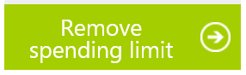
Limits and Quotas
There are soft limits and hard limits
Initially subscriptions have fairly low limits to help protect you from over use
http://azure.microsoft.com/en-us/documentation/articles/azure-subscription-service-limits/
You can increase these by contacting Azure support
http://azure.microsoft.com/blog/2014/06/04/azure-limits-quotas-increase-requests/
On your account you can enable or remove spending limits
Notes:
Select View more details under the credit status then click the Remove Spending Limit and confirm

Slide 15
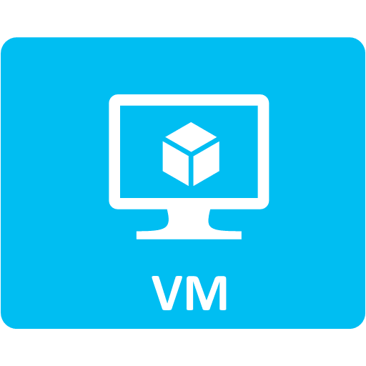
IaaS in 4 words
VM in the cloud
Infrastructure
as a Service
Applications
You manage
Data
Runtime
Middleware
O/S
Virtualization
Vendor Manages
Servers
Storage
Networking
Notes:
Remember the pillars
The fabric and hypervisor is managed by the provider
You manage everything inside the VM box
The OS
The app
The data
You have to patch the OS and app
You have to back up what you care about
You need to monitor
There are aspects of Azure that help
Azure Backup with IaaS VM support
Azure Agent can help deploy PowerShell DSC/Chef/Puppet, malware protection and definition updates etc
Azure makes sure the VM is available and provides resiliency for the storage but if your VM blue screens Azure won’t do anything
If SQL running in your VM is not optimized Azure won’t do anything

Slide 16

What are the costs?
≠
Staff
Tools
Backup
Application – SQL, etc.
Per Minute Compute (includes Windows Server License)
OS – Windows/Linux
Virtualization – [VMware]
Per GB Storage
Fabric/Connectivity – Servers,
SAN, Switches, Cables, Maintenance, T1, MPLS
Per GB Egress
Per Minute App License (SQL, BizTalk, Oracle)
Datacenter – Building Lease, Power,
HVAC, Insurance, DR
** Periodic Refresh **
** Buy in advance then use **
** Buy as needed **
Does it need to run 24/7?
Notes:
Certainly a lot to think about!
Think about shift in mindset. On-premises run all the time as its there but in public cloud you can turn on/off based on need. Key difference!!!!
You may know exactly what your costs are but its very hard to do
Staff will vary greatly and how much automation you have can have big impact on staff costs etc
ExpressRoute

Slide 17
Azure costs and licenses
Azure VM Pricing
https://azure.microsoft.com/en-us/pricing/details/virtual-machines/
Azure Pricing Calculator
http://azure.microsoft.com/en-us/pricing/calculator/
Organizations may get different rates based on agreements and use BYoL
MSDN has lower rates as license not required for Windows instances
Azure Cost Estimator
http://www.microsoft.com/en-us/download/details.aspx?id=43376&WT.mc_id=rss_alldownloads_all
Microsoft can help with TCO assessments
Notes:
Show cost calculator
Show different price between windodws and linux vm (because windows includes license)
Show different price for SQL vs Windows and explain option of bring own license or lease from Azure
Show marketplace as well for even more software options
Talk about MSDN gets reduced rates because you don’t have to pay for OS license
http://azure.microsoft.com/en-us/pricing/member-offers/msdn-benefits-details/

Slide 18
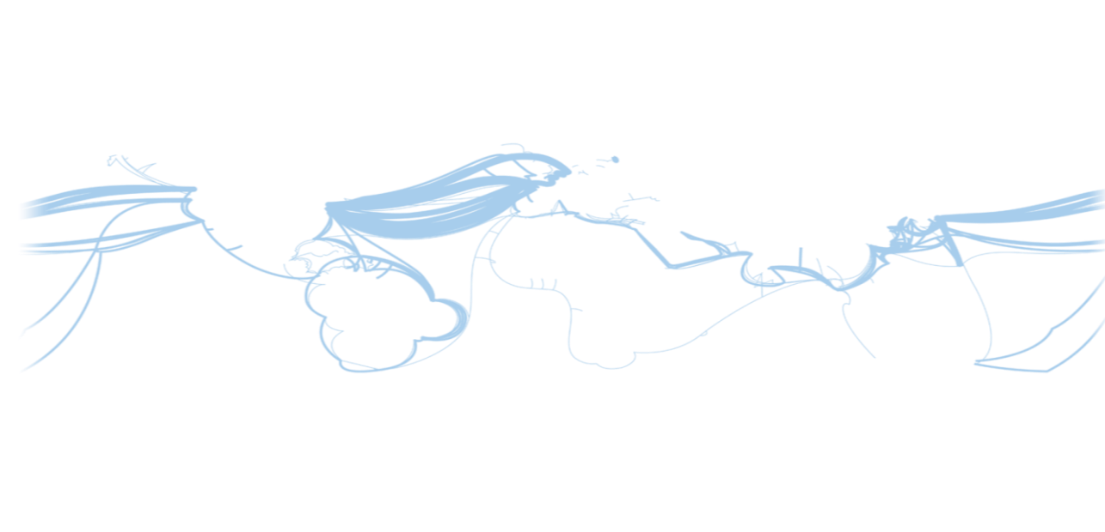
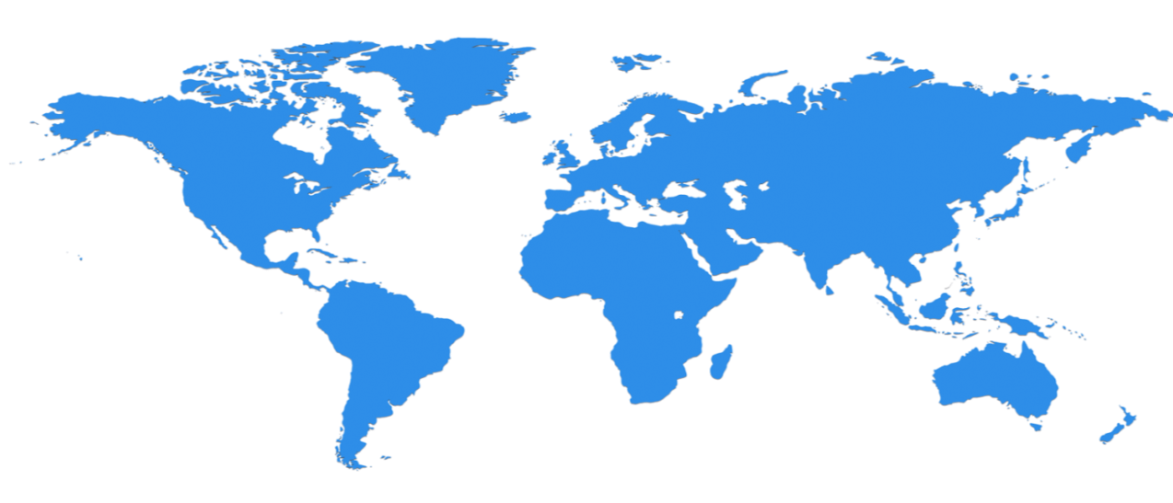

Azure Regions
100+ Datacenters across 30 Regions (22 Generally Available) Worldwide
North Central US
Illinois
United Kingdom
Regions
West Europe
Netherlands
Canada Central
Toronto
United Kingdom
Regions
Central US
Iowa
Canada East
Quebec City
Germany North East **
Magdeburg
US Gov
Iowa
China North *
Beijing
US DoD West
TBD
North Europe
Ireland
Germany Central **
Frankfurt
China South *
Shanghai
Japan East
Tokyo, Saitama
East US
Virginia
West US
California
India Central
Pune
Japan West
Osaka
East US 2
Virginia
US Gov
Virginia
India South
Chennai
South Central US
Texas
India West
Mumbai
East Asia
Hong Kong
US DoD East
TBD
SE Asia
Singapore
Australia East
New South Wales
Brazil South
Sao Paulo State
Australia South East
Victoria
Top 3 networks in the world
2.5x AWS, 7x Google DC Regions
G Series – Largest VM in World, 32 cores, 448GB Ram, SSD…
Operational
Announced/Not Operational
* Operated by 21Vianet ** Data Stewardship by Deutsche Telekom
Notes:
This is from the new preview portal that shows region health https://portal.azure.com
India and Canada datacenters coming
Also same regions available when deploying to a region
Show the available regions from the portal when creating a VM
https://azure.microsoft.com/en-us/regions/
https://azure.microsoft.com/en-us/regions/#services
Note this is more than AWS and Google combined

Slide 19

Region pairings
US West | US East
US North | US South
US Central | US East 2
Europe North | Europe West
Asia East | Asia South East
China North | China South
Japan East | Japan West
South Brazil | US South
Australia East | Australia Southeast
Central India (Pune) | South India (Chennai)
South India (Chennai) | Central India (Pune)
West India (Mumbai) | South India (Chennai)
Canada Central | Canada East
Regions are paired for failover and replication for geo-replicated storage
Async
Region
Region
Notes:
3 times in each location
Update 1/28/2016
Added India locations. Note for India the left hand column is the primary while the right hand is secondary, i.e. Pune replicates to Chennai.

Slide 20
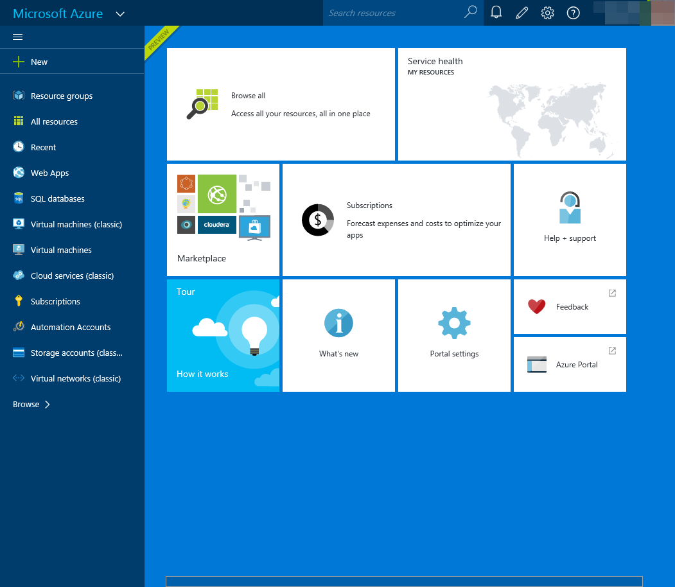
Azure Portals
Currently two portals
Classic Portal (v2)
HTML5 based
Focused on a single activity
Does not support RBAC or ARM
Azure Portal (v3)
New architecture using blades, lenses and parts
Multiple concurrent activities
Does not support all services currently
Notes:
Show both portals and walk through basic infrastructure
Get students to walk through the portals
https://manage.windowsazure.com
https://portal.azure.com

Slide 21
Lab
1.1 – Azure Portals – 20 min
portal.azure.com
manage.windowsazure.com
account.windowsazure.com
*ea.azure.com

Slide 22
VMs with Azure IaaS

Slide 23
Azure VM Hosting Infrastructure
Uses Hyper-V for the hypervisor
Easy mobility between on-premises Hyper-V and Azure IaaS
Uses Generation 1 VMs and VHD format
VHD disks must be 1023 GB or less in size
64-bit operating systems only
Windows 2008 R2 and above and many Linux distributions

Slide 24
Azure VM Characteristics
Azure VMs are created of a specific series, tier and size. Each series has different scale and capabilities
Sizes impact CPU, memory, temporary storage size, number of data disks and network adapters, network egress and some advanced features (e.g. RDMA)
Tier impacts IOPS, egress and some features (load balancing and auto-scale)
Series | Description
A | General purpose VMs with HDD temporary drive
D [v2] | SSD temporary drives with faster processors than A (v2 35% faster than D v1)
DS | D series with support Azure Premium Storage connectivity
F | Compute optimized with 2 GB of RAM and 16 GB of SSD per core
FS | F series with support for Azure Premium Storage connectivity
G | Performance compute with massive scale and SSD temporary drives
GS | G series with support Azure Premium Storage connectivity
N | GPU capabilities for graphical intensive workloads
Notes:
https://azure.microsoft.com/en-us/documentation/articles/virtual-machines-size-specs/ . Walk through the key characteristics
Also show the information shown in the new portal at the creation page
Also note A8 and A9 and N21 have RDMA
https://azure.microsoft.com/en-gb/pricing/details/virtual-machines/#Windows

Slide 25
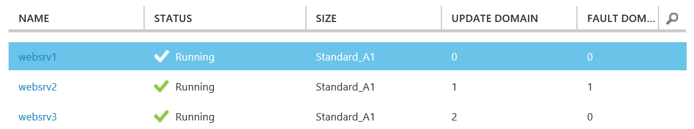
Availability Sets
At least two instances of any services should always be deployed in an Availability Set
This ensures availability of the service in planned and unplanned situations
Placing VMs in an Availability Set tells Azure to ensure they are distributed over three fault domains (ARM) and five update domains
Notes:
ARM uses 3 fault domains
Note if you have 10 you would potentially have 5 on each fault domain, not split over 10 fault domains
Notice there is also the concept of an Update Domain which is how Azure will upgrade hosts so being split over update domains ensures a service won’t all get taken down when performing planned maintenance
http://blogs.technet.com/b/yungchou/archive/2011/05/16/window-azure-fault-domain-and-update-domain-explained-for-it-pros.aspx

Slide 26
Don’t mix workloads in Availability Set
One Availability Set for each type of workload
Remember spreads all over three fault domains
If you mix you could get all of one type on one fault domain and all the other type on another which would not provide protection for the workload
Single Availability Set
IIS Availability Set
IIS
IIS
SQL
IIS
IIS
SQL
SQL
SQL
SQL Availability Set
Fault Domain
Fault Domain
Fault Domain
Fault Domain
Notes:
Create VMs in different storage accounts to minimize chance a storage account problem takes down the VMs
Also ideally also split services over multiple regions and use services such as Azure Traffic Manager to balance between

Slide 27
IaaS VM Service Level Agreement
Defined at http://azure.microsoft.com/en-us/support/legal/sla/
For VMs that have at least two instances and are part of an Availability Set the SLA is 99.95% availability
Backed by service credit
No SLA for single VMs*
Azure hosts go down for maintenance around once a month but patching is via updated OS image and reboot rather than typical OS patching used by most companies
New VMPHU utilized to minimize downtime in planned maintenance
Notes:
http://www.microsoft.com/en-us/download/details.aspx?id=38427 specific to VMs
http://blogs.msdn.com/b/avkashchauhan/archive/2011/11/27/windows-azure-instance-uptime-and-instance-re-initialization.aspx
VM-PHU preserving host update
http://www.faqs.org/patents/app/20140157264

Slide 28
Using the Marketplace Templates
Marketplace templates for:
Windows Server OS (2008 R2 and above)
Linux distributions
Windows Server OS with server applications preinstalled (SQL, Biztalk, SharePoint etc)
3rd party applications/virtual appliances
Many provide option to pay for license based on consumption through MS billing or Bring Your Own License (BYOL)
Windows Server images include OS license or take advantage of Hybrid Use Benefit (HUB)
MSDN subscriptions feature reduced cost for Windows Server images and enable Windows client for development purposes only
Notes:
Includes RHEL per http://news.microsoft.com/2015/11/04/microsoft-and-red-hat-to-deliver-new-standard-for-enterprise-cloud-experiences/

Slide 29
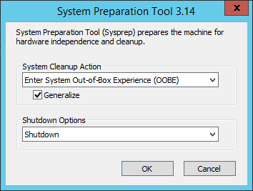
Using a Custom Template
Most organizations have a customized OS image used on-premises
Custom images can be uploaded that have been SYSPREP’d to be used for new VM creation in Azure
Also possible to create a new image directly from an Azure VM
Image must not contain an unattend.xml as this is created and attached to VM by Azure fabric management at creation for VM configuration
Notes:
Creating custom templates in Windows Azure IaaS
http://msdn.microsoft.com/en-US/library/azure/dn790290.aspx
http://azure.microsoft.com/en-us/documentation/articles/virtual-machines-linux-create-upload-vhd/
http://azure.microsoft.com/en-us/documentation/articles/virtual-machines-create-upload-vhd-windows-server/
Ideally shutdown the VM first
Save-AzureVMImage -ServiceName savtecheastus -Name sandbox -ImageName "sandboximage" -OSState Generalized
http://windowsitpro.com/azure/create-azure-image-existing-virtual-machine
Note you do not have SYSPREP first and don’t even have to shutdown. Can run in state of specialized instead of generalized
It takes a copy of all disks
When create a new deployment of the image all the data disks are also copied to the new deployment

Slide 30
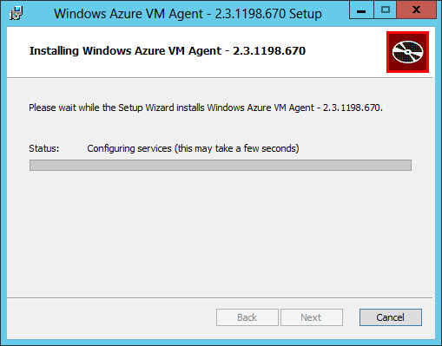
VM Agent
The VM Agent is installed by default but for older VMs you can manually install from http://go.microsoft.com/fwlink/?LinkID=394789&clcid=0x409
Once installed in the VM you need to tell the Azure fabric the agent is installed
$vm = Get-AzureVM –ServiceName <cloud service name> ` –Name <vm name>
$vm.VM.ProvisionGuestAgent = $true
Update-AzureVM –Name <vm name> –VM $vm.VM ` –ServiceName <cloud service name>
Get-AzureVM –ServiceName savilltecheastuscs -Name savazudc01
Notes:
http://windowsitpro.com/azure/install-azure-iaas-vm-agent-virtual-machine
http://blogs.msdn.com/b/wats/archive/2014/04/08/install-the-vm-agent-on-an-existing-azure-vm.aspx
Agent info - http://blogs.msdn.com/b/wats/archive/2014/02/17/bginfo-guest-agent-extension-for-azure-vms.aspx
Get-AzureVM –ServiceName savnetazu115 -Name savazudc01 #Will see the GuestAgentStatus is populated
PS C:\Users\josavi> Get-AzureVM –ServiceName savilltecheastuscs -Name savazudc01 #Will see the GuestAgentStatus is populated
DeploymentName : savazudc01
Name : savazudc01
Label :
VM : Microsoft.WindowsAzure.Commands.ServiceManagement.Model.PersistentVM
InstanceStatus : ReadyRole
IpAddress : 10.7.115.13
InstanceStateDetails :
PowerState : Started
InstanceErrorCode :
InstanceFaultDomain : 0
InstanceName : savazudc01
InstanceUpgradeDomain : 0
InstanceSize : Medium
AvailabilitySetName :
DNSName : http://savilltecheastuscs.cloudapp.net/
Status : ReadyRole
GuestAgentStatus : Microsoft.WindowsAzure.Commands.ServiceManagement.Model.PersistentVMModel.GuestAgentStatus
ResourceExtensionStatusList : {Microsoft.Compute.BGInfo}
PublicIPAddress :
PublicIPName :
ServiceName : savilltecheastuscs
OperationDescription : Get-AzureVM
OperationId : a7194ceabbd7cde49b3137bd28621145
OperationStatus : OK
http://azure.microsoft.com/blog/2014/04/11/vm-agent-and-extensions-part-1/

Slide 31
VM Extensions
Enable additional functionality through the agent
Integration with Azure Backup
Malware protection deployment and update
Chef/Puppet/PowerShell DSC integration
Local password reset and RDP reset
BGInfo utilization
All extensions can be seen using:
Get-AzureVMAvailableExtension | Out-GridView
Notes:
Extensions support partner ecosystem to bring additional value
RDMA Drivers in A8/A9 are installed via the extensions
$vm = Get-AzureVM –ServiceName SavillMinecraft –Name MineCraftSrv
http://azure.microsoft.com/blog/2014/04/11/vm-agent-and-extensions-part-1/
Extensions registered are listed at the bottom of VM dashboard in portal
Enable BGInfo to set background with info
Set-AzureVMBGInfoExtension -VM $VM
Reset local password in VM
Set-AzureVMAccessExtension -VM $VM –UserName "localadmin" –Password "P@55word!" –ReferenceName Reset-Pass1
Enable RDP and required firewall exception
Set-AzureVMAccessExtension -VM $VM
After any extension change have to update the VM
$VM | Update-AzureVM

Slide 32

Use of Cloud Services
IaaS VMs with Azure Service Manager were created inside a Cloud Service which provided a Virtual IP (VIP), DNS name, load balancing and auto-scale capabilities
PaaS can utilize Cloud Services for deployment slots and VIP swapping to move deployments between slots but Cloud Service not required with ARM PaaS
Azure Resource Manager IaaS no longer uses Cloud Services
RDP to VIP:52513
Endpoint
52513 -> VM1:3389
VIP
3389
VM1
Switch
VIP1
VIP2
3389
VM2
Production
Staging
Notes:
http://azure.microsoft.com/en-us/documentation/articles/cloud-services-how-to-manage/

Slide 33
What is Azure Resource Manager?
Focused around resources which is an Azure entity such as a website, storage account, VM
Resources reside in one (and only one) Resource Group
Parallel actions/deployment on large scale
Resource groups visible through the new portal
Resource Groups can span regions and be heterogeneous or homogeneous
Resource Groups roll-up contained resources for billing, lifecycle and access
Full Role-Based Access Control and tagging
JSON based deployments with dependencies fully supported and auto populated
Today it is not possible to mix ARM and non-ARM resources
Notes:
https://azure.microsoft.com/en-us/documentation/articles/virtual-machines-azurerm-versus-azuresm/
Call rest from powershell
http://windowsitpro.com/azure/communicate-azure-rest-powershell

Slide 34

IaaS with ARM
Load Balancer with VIP
DIP1
DIP2
DIP3
PIP1
Availability Set
Virtual Network
Resource Group
Notes:
Firstly there is no cloud service. That is dead for IaaS (still there for PaaS)
IaaS v2 using ARM changes this and removes the use of the Cloud Service (PaaS still uses Cloud Services) and instead all VMs must now be part of a Virtual Network and live within a Resource Group which can also contain other types of resource such as storage. Because there is no cloud service the functions of the cloud service move to other constructs. VMs can have their own Internet routable IP address that is not shared using an instance-level public IP address (PIP) giving a VM direct Internet connectivity (note PIPs can also be used with IaaS v1). Alternatively it is possible to create a load balancer resource and assign a VIP to the load balancer which points to network adapters assigned to VMs.
The order of performing actions in IaaS v2 is:
Create a Resource Group (which can contain resources from all over the world)
Create or ensure there is an existing ARM (v2) storage account and virtual network to be used by the new VM. You cannot use non-ARM virtual networks or storage accounts with an ARM based VM
Create a network adapter object which must be placed in a virtual network (the virtual network does not have to be in the same resource group as the VMs)
Create a VM and attach the network adapter object to it
Add either a PIP to the network adapter or create a load balancer and assign a VIP then create NAT rules to enable Internet access to the VM services. Typically if you have a single VM needing to offer services you can assign a PIP but for larger scale use a network load balancer with NAT rules
If you think of equating IaaS v1 to IaaS v2 I think the following:
The DNS name that was previously assigned to the Cloud Service now is configured as part of a VIP assigned to a load balancer. <domainlabel>.<region>.cloudapp.azure.com is new format instead of cloudapp.net
The container for expressing availability is now directly the Availability Set (which supports 3 Fault Domains)
Load balancers are now a discrete object that is referenced when creating virtual network adapters and assigning to a VM
The VIP is now assigned to a load balancer (or use a PIP directly with a VM)
Endpoints are now NAT rules on the load balancer
VMs are always placed in Virtual Networks
Certain discrete resources must be provisioned before the VM is created such as network adapters

Slide 35
Creating a VM using the Portal
Portals enable creation of Azure services including VMs
Use the portal to experiment and become familiar with service options
Portals can also be used for end-user access/management using RBAC
For production and longer term should use mechanisms that can be automated and repeatable such as PowerShell/templates
In a disaster would need to recreate VMs which would be cumbersome from an interactive portal
Consider using existing Service Catalog for offering additional services based in Azure
Notes:
Could create Orchestrator runbook and offer by Service Manager request offering

Slide 36
AzureRM PowerShell
Separate PowerShell modules for ARM (AzureRM) vs ASM (Azure)
ARM cmdlets use AzureRM in the cmdlet name
Installed from Github once basic installed module installed
Set-ExecutionPolicy RemoteSigned #Required to install the modules
Install-Module AzureRM #Install the Azure RM modules
Install-AzureRM #Download and install each module of Azure RM
Import-Module AzureRM #Load ARM cmdlets
Use Login-AzureRmAccount to login instead of Add-AzureAccount (ASM)
Notes:
31dec2015.htm FAQs for example creation
http://windowsitpro.com/azure/finding-images-azure-powershell
http://windowsitpro.com/azure/create-new-vm-using-azurerm-cmdlets
http://windowsitpro.com/azure/azure-powershell-10-changes
http://windowsitpro.com/azure/view-status-arm-vms-using-powershell
http://windowsitpro.com/azure/get-latest-version-azure-powershell-1
A. Azure PowerShell 1.0 represents a new direction for the management of Azure Resource Manager resources vs Azure Service Manager resources. Prior to 1.0 the Switch-AzureMode cmdlet was used to switch between ARM and ASM management and cmdlets with the same name were used in each mode but behaved very differently. With 1.0 the ARM cmdlets all have RM in the name, for example Get-AzureRMVM instead of Get-AzureVM. This means a switch of mode is no longer required as you specifically use the ARM cmdlets which are also in a separate module.
The new Azure PowerShell 1.0 can be downloaded from https://azure.microsoft.com/en-us/downloads/ under the Command-line tools section. Note that the pre 1.0 is still available as the legacy PowerShell library. Once installed you need to download the various modules that make up the AzureRM and Azure PowerShell environments. This can be done with the following commands from an elevated PowerShell window.
Set-ExecutionPolicy RemoteSigned #Required to install the modules Install-Module AzureRM #Install the Azure RM modules Install-AzureRM #Download and install each module of Azure RM Install-Module Azure $Install the ASM module
Import-Module AzureRM #Load ARM cmdlets Import-Module Azure #Load ASM cmdlets (note you would likely only use one of these cmdlets)
Q. How can I view the status of my ARM VMs using PowerShell? Dept - Azure
A. To view the status of an Azure RM VM using PowerShell you must add the -Status parameter which includes an array of statuses, one of which is the current powerstate., e.g.
Get-AzureRmVM -ResourceGroupName "SAVILLTECHRGEASTUS" -Name "testvm44" -Status
To view the status for all VMs you could use something like the following:
$RGs = Get-AzureRMResourceGroup foreach($RG in $RGs) { $VMs = Get-AzureRmVM -ResourceGroupName $RG.ResourceGroupName foreach($VM in $VMs) { $VMDetail = Get-AzureRmVM -ResourceGroupName $RG.ResourceGroupName -Name $VM.Name -Status foreach ($VMStatus in $VMDetail.Statuses) { if($VMStatus.Code.CompareTo("PowerState/deallocated") -eq 0) { $VMStatusDetail = $VMStatus.DisplayStatus } } write-output $VM.Name $VMStatusDetail } }
Basically in the above PowerShell I go through all resource groups for all VMs and for each find the status related to power state then output.
Q. How can I get the latest version of the Azure 1.0 PowerShell? Dept - Azure
A. To update the Azure modules from 1 and above run the following two commands:
Update-Module AzureRM Update-AzureRM

Slide 37
Lab
2.1 – AzureRM PowerShell – 60min
Portal – get template
Powershell – login, find subscription, deploy

Slide 38
JSON Templates for Creation
Large library on github (https://github.com/Azure/azure-quickstart-templates)
Nice looking version at https://azure.microsoft.com/en-us/documentation/templates/ with better help
Just call the template with any custom values needed
New-AzureRmResourceGroupDeployment -Name <deployment-name> ` -ResourceGroupName <resource-group-name> ` -TemplateUri https://raw.githubusercontent.com/azure/ azure-quickstart-templates/master/101-vm-simple-windows/ azuredeploy.json
Notes:
Show http://azure.microsoft.com/en-us/documentation/templates/ as a better formatted version of the github
It is possible to use PowerShell
https://azure.microsoft.com/en-us/documentation/articles/powershell-azure-resource-manager/
Nice example - https://github.com/azurermtemplates/azurermtemplates/tree/master/resource-loop-vm-availabilityset-20UDs
Will automatically populate any dependency values for you
11jun2015.htm
http://windowsitpro.com/azure/how-do-i-use-template-create-vms-azure-iaas-v2-arm
Q. How do I use a template to create VMs in Azure IaaS v2 (ARM)? Dept - Azure
A. Using a JSON template provides a repeatable and resumable way to create one VM or multiple VMs which can even make up a multi-tiered services. Services inside a template are deployed in parallel unless there are dependencies in which case the resource at the bottom of the dependency stack is deployed first, then the resources that depend on that resource and so on.
While you can create your own templates using any JSON editor including a regular text editor or more advanced tools such as Visual Studio the best way to is look at existing templates which are available at GitHub. https://github.com/Azure/azure-quickstart-templates is the library for Azure Resource Manager (ARM) templates and a better formatted version is available at http://azure.microsoft.com/en-us/documentation/templates/. A great template to start with is the 101-simple-windows-vm which deploys a single VM. Notice there are a number of files for all templates:
<template>.json - This is the main template file
<tempalte>.parameters.json - The parameters that can be passed to the template and while optional provides a way to prepopulate values that can be passed when creating an instance of the template
metadata.json - Data about the template used by Azure to enable its use and publication
README.md - Information about the template and often a button that deploys the template to Azure by loading the template into the template editor in the Azure portal
Each file can be viewed in the GitHub by selecting the file and downloading. The only file you must download is the main template file. There are also templates in Azure can also be viewed and downloaded using PowerShell once you have authenticated with an Azure AD account and switched to ARM mode:
Add-AzureAccount
Switch-AzureMode -Name AzureResourceManager
Templates can then be viewed and downloaded.
Get-AzureResourceGroupGalleryTemplate -Publisher Microsoft Get-AzureResourceGroupGalleryTemplate -Identity Microsoft.WindowsServer2012Datacenter.0.2.77-preview Save-AzureResourceGroupGalleryTemplate -Identity Microsoft.WindowsServer2012Datacenter.0.2.77-preview -Path D:\Temp\Microsoft.WindowsServer2012Datacenter.0.2.77-preview.json
Open up the downloaded JSON file and view the parameters that are required. Below is an example parameter section:
"parameters": { "newStorageAccountName": { "type": "String" }, "newDomainName": { "type": "String" }, "newVirtualNetworkName": { "type": "String" }, "vnetAddressSpace": { "type": "String" }, "hostName": { "type": "String" }, "userName": { "type": "String" }, "password": { "type": "SecureString" }, "location": { "type": "String" }, "hardwareSize": { "type": "String" } } These values need to be populated when deploying the template. When you deploy the template the parameters will be parsed and added to the command which can be viewed through the IntelliSense in the PowerShell ISE or by tabbing. For example:
Make sure all parameters are populated for the template. If you miss parameters you will be prompted for them, for example:
PS D:\temp> New-AzureResourceGroup -Name TestRGDeploy -Location "East US" -GalleryTemplateIdentity Microsoft.WindowsServer2012Datacenter.0.2.77-preview cmdlet New-AzureResourceGroup at command pipeline position 1 Supply values for the following parameters: (Type !? for Help.) newStorageAccountName:
The same applies to templates downloaded from GitHub except -TemplateFile is used instead of -GalleryTemplateIdentity, for example:
New-AzureResourceGroup -Name TestRGDeploy -Location "East US" -TemplateFile D:\temp\101-simple-windows-vm.json
If you downloaded the parameter file and populated it with values you would need to pass this using the -TemplateParameterFile <file> parameter.
Microsoft has a good article on ARM with PowerShell at https://azure.microsoft.com/en-us/documentation/articles/powershell-azure-resource-manager/ which should be reviewed. Also see https://azure.microsoft.com/en-us/documentation/articles/virtual-machines-azurerm-versus-azuresm/ for general information.

Slide 39
Lab
2.2 – JSON Templates – 30 min

Slide 40
Using Azure Storage

Slide 41
Azure Storage 101
Azure does not use traditional storage such as Storage Area Networks. Instead it uses a 3 tier architecture within storage stamps
DNS is used for the namespace which is why URIs used to access, e.g. http(s)://<account>.<service>.core.windows.net/<partition>/<object>
Data is replicated in two ways
Intra-stamp replication (stream layer) – Synchronous and keeps data durable within the stamps through replication across nodes in different fault domains
Inter-stamp replication (partition layer) – Asynchronous replication of data across stamps
Front-End Layer
Partition Layer
Stream Layer
Notes:
Storage Stamps – A storage stamp is a cluster of N racks of storage nodes, where each rack is built
out as a separate fault domain with redundant networking and power. Clusters typically range from
10 to 20 racks with 18 disk-heavy storage nodes per rack. Our first generation storage stamps hold
approximately 2PB of raw storage each. Our next generation stamps hold up to 30PB of raw
storage each.
Stream Layer – bits on the disk and responsible for distributing and replicating the data across servers in the stamp to keep data durable. A file (stream) is an ordered list of large storage chunks (extents which are the units of replication) which are made up of blocks.
Partition Layer – Understands higher level data abstractions such as blobs, tables and queues and provides scalable namespace
Front-End Layer – Stateless servers that take requests, looks up account name, authenticates etc then route via partition layer
Based on work done via Bing (Cosmos) for replication
http://sigops.org/sosp/sosp11/current/2011-Cascais/11-calder-online.pdf
http://sigops.org/sosp/sosp11/current/2011-Cascais/11-calder.pptx

Slide 42
Storage Accounts
Top-level namespace for storage services
Created in a region
Can be geo-replicated (with read-only access to replica)
Accessed via URL and storage access keys (2) used for controlled access (never share!)
500 TB of data per regular storage account, 35 TB for Premium Storage account
20,000 IOPs per regular storage account, Premium Storage accounts do not have an explicit limit but the capacity limit indirectly restricts the IOPS
Can enable monitoring and logging
New blob type account supporting hot and cold tier but not for VHD use
Notes:
Configure page where monitoring etc can be enabled
http://azure.microsoft.com/en-us/documentation/articles/storage-monitor-storage-account/
(FYI, 35TB on Premium Storage will provide over 150,000 IOPS)
Show URLs
TALK ABOUT TYPES OF REPLICATION
Geo redundancy (Geo Redundant Storage, GRS). Read-Access GRS (RA-GRS)
http://azure.microsoft.com/en-us/documentation/articles/azure-subscription-service-limits/
Blob accounts do not support page blobs. Only regular blob. Cold is half the cost for storage but double the cost for transactions.

Slide 43


Virtual Machine Storage
Temp
Node
OS
Data
x3
Azure Storage
Paired Region
Notes:
D: is non-persistent
Walk through an Azure VM that has storage attached to it
Key Points to explain
Virtual Machine has an OS VHD which is stored in Azure Storage (127 GB)
Virtual Machine has a temporary drive, D:, which is not-persistent (20GB - 6TB depending on VM size)
Pagefile
Can be used as scratch drive
Do not put anything you care about on this drive
HDD based (A series), SSD based (D, DS and G series)
You can add additional data disks (1-64 depending on VM size)
1 TB (1023 GB, not a typo)
Fixed VHD
500 IOPS per disk (300 IOPS for basic tier)

Slide 44
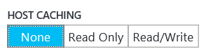
Types of caching
OS disk – Read/Write or Read-only Cache (ARM adds None option but not ASM)
Data disks – All states supported
Typically database data should have all caching disabled
SQL Server
Active Directory Database
Most application data should be placed on Data Disks
Change using PowerShell (ARM and ASM)
$vm.StorageProfile.OsDisk.Caching = 'None' # or ReadOnly ReadWrite
Update-AzureRmVM -VM $VM -ResourceGroupName RG-SCUSA
Set-AzureOSDisk –HostCaching ReadOnly|ReadWrite (requires reboot)
Set-AzureDataDisk –HostCaching ReadOnly|ReadWrite|None
Notes:
OS can be set to Read only-caching at minimum
Premium Storage use read-only caching by default
http://blogs.msdn.com/b/windowsazurestorage/archive/2012/06/28/exploring-windows-azure-drives-disks-and-images.aspx
Can change the cache setting

Slide 45
Premium Storage
Regular Azure storage is primarily HDD based
Premium Storage is based on SSD storage
Provides a predictable level of performance compared to unpredictable MAX performance for regular storage
Three disk types and the size used for a VHD controls which disk type is selected
Must be used with DS or GS-series VMs which have varying IOPS limits
Disk Types | P10 | P20 | P30
Disk Size | 128 GB | 512 GB | 1024 GB
IOPS per Disk | 500 | 2300 | 5000
Throughput per Disk | 100 MB/sec | 150 MB/sec | 200 MB/sec
Notes:
You do not specify a disk type, the disk type is chosen based on the size of disk you create and rounder up to the applicable disk type. Therefore any disk 128 GB or smaller will be a P10, any disk between 129 and 512 will be a P20 and any disk over 512 will be a P30.
https://azure.microsoft.com/en-us/documentation/articles/storage-premium-storage-preview-portal/
http://azure.microsoft.com/en-us/pricing/details/storage/ - use east us2 to see pricing
http://azure.microsoft.com/blog/2014/12/11/introducing-premium-storage-high-performance-storage-for-azure-virtual-machine-workloads/
http://azure.microsoft.com/en-us/documentation/articles/storage-premium-storage-preview-portal/
http://azure.microsoft.com/blog/2015/04/16/azure-premium-storage-now-generally-available-2/
http://azure.microsoft.com/en-us/pricing/details/storage/ - use east us2 to see pricing
DS required as to ensure predictable performance local SSD is used along with RAM to form a Blobcache. This is why DS has smaller temp drive than D (because delta is used for caching)
GS coming soon allow premium storage to be used with G series
Q. What are the limits associated with Azure Premium Storage?
A. For regular Azure storage accounts there is an IOPS limit and a capacity limit. Premium Storage accounts have a 35 TB limit but not a fixed IOPS limit. Instead the capacity limit indirectly restricts the amount of IOPS per Premium Storage account. Based on the 35 TB limit it would be possible to get around 150,000 IOPS from a single Premium Storage account.

Slide 46
Fixed VHD in Azure
Azure uses fixed size VHDs where the size of the VHD is provisioned at creation time
In Azure you pay for what you consume which would typically mean creating the smallest VHD that meets your need
Azure Storage uses sparse storage on the back end and also supports trim type operations
Therefore if your 1 TB VHD only has 50 MB of data stored in it then only 50 MB of Azure Storage is actually used and therefore you pay for the 50 MB only
This is not the same for Premium Storage where cost is based on the disk created
Notes:
Don’t do full format
Show size of vhd in container. 127
https://gallery.technet.microsoft.com/Get-Billable-Size-of-32175802 –view actual size
PS C:\tools> .\CalculateBlobCost.ps1 -storageaccountname "savtechstorenortheurope"
On win81g2
Show the VM and space uses inside the VM which will correlate
http://windowsitpro.com/azure/q-does-azure-premium-storage-use-sparse-storage
Q. Does Azure Premium Storage use sparse storage?
A. Regular Azure storage uses sparse storage. This means if a 1 TB fixed-size virtual hard disk (VHD) is created, but only 100 MB of data is written on the Azure fabric, then only 100 MB of data is actually written to the storage fabric* and you are only charged for 100 MB.
Azure Premium Storage works differently: you pay for the type of Azure Premium Storage disk you buy, regardless of how much data is written to it, because you are buying a predictable performance rather than a maximum performance.
At time of my writing this, there are 3 types of Azure Premium Storage disk, the P10, P20 and P30 as shown below.
Premium Storage Disk TypeP10P20P30Disk Size128 GB512 GB1024 GBIOPS per disk50023005000Throughput per disk100 MB per second150 MB per second200 MB per secondPrice per month (exact price may vary)$17.92$66.56$122.88For the most current pricing see http://azure.microsoft.com/en-us/pricing/details/storage/.
When using the Azure portal you can only select one of the sizes listed above as shown below. If using PowerShell you can create other sizes however the actual performance allocation and billing will be rounded up to a specific Premium Storage disk type, i.e. if you create a 200 GB disk it will actually have the performance and billing of a P20 (512 GB). If you only write 10 MB of data you still pay the monthly price of that P20.

Slide 47
Volume size requirements larger than 1 TB
Depending on the size of the VM you can add up to 64 data disks
Use Storage Spaces inside the VM to create a simple space combining the separate data disks
Do NOT use RAID sets
Do NOT use parity or mirrored Storage Spaces, only simple (the storage is already replicated 3 times and is resilient)
For SQL workloads you could choose to use SQL’s own file group capabilities
Combing disks also gives higher IOPS which is another reason to use multiple disks in a Storage Space
Notes:
(if more than 8 disks set number of columns to match number of disks)
http://windowsitpro.com/azure/storage-performance-sql-server-azure-iaas
http://msdn.microsoft.com/en-us/library/dn248436.aspx
VM sizes - https://azure.microsoft.com/en-us/documentation/articles/virtual-machines-size-specs/

Slide 48
Best Practices for Storage Resiliency in Availability Sets
Keep all Disks (OS and Data) associated with a VM in the same Storage Account
Storage account limits should be considered when adding more VHDs to a storage account
Use separate storage account for each VM in an Availability Set. Multiple VMs in the same availability set must NOT share the same storage account.
It is acceptable for VMs across different Availability Sets to share storage accounts as long as the best practices above are followed
VM Availability Set
VM #1
VM #2
FD0
FD1
Disks
SA1
SA2
SA1
SA2
Storage Scale
Unit 1
Storage Scale
Unit 2
Microsoft Confidential – Shared Under NDA – Do Not Distribute

Slide 49
Customer VM Configurations: Single Storage Scale Unit
Availability Set has 2 or more VMs for redundancy
Each VM uses separate storage account, but all accounts are located on a single Storage scale unit
Risk: Not resilient to single Storage scale unit failures
Action:
Azure Engineering team will migrate the storage accounts to different scale units
No customer action needed
No downtime required
VM Availability Set
VM #1
VM #2
FD0
FD1
Disks
SA1
SA2
Storage Scale
Unit
Microsoft Confidential – Shared Under NDA – Do Not Distribute

Slide 50
Customer VM Configurations: Single Storage Account
Availability Set has 2 or more VMs for redundancy
All VMs have disks which use a Single Storage Account
Risk: Not resilient to single Storage scale unit failures
Action:
Customer has to isolate and use separate storage account for each VM
Azure Engineering team can migrate the storage accounts to different scale units
VM Availability Set
VM #1
VM #2
FD0
FD1
Disks
SA1
Storage
Scale
Unit
Microsoft Confidential – Shared Under NDA – Do Not Distribute

Slide 51
Customer VM Configurations: Shared Storage Accounts
Availability Set has 2 or more VMs for redundancy
VMs have multiple disks. The disks are in multiple storage accounts either on the same scale unit or different scale unit
Risk: Not resilient to any storage scale unit failures. Both VMs will be impacted if any of the scale units are down
Action:
Customer has to isolate and use separate storage account for each VM
Azure Engineering team can migrate the storage accounts to different scale units, if needed
VM Availability Set
VM #1
VM #2
FD0
FD1
Disks
SA1
SA2
SA1
SA2
Storage Scale
Unit 1
Storage Scale
Unit 2
Microsoft Confidential – Shared Under NDA – Do Not Distribute

Slide 52
Availability Set with Managed Disks
Compute cluster
Non-Managed VM Availability Set
Managed VM Availability Set
VM #1
VM #2
VM #1
VM #2
VM #3
FD0
FD1
FD0
FD1
FD2
Non-Managed Disks
Managed Disks
Storage
Unit 0
Storage
Unit 1
Storage
Unit 2
Storage
Unit
FD0
FD1
FD2
Storage isolation of VM Availability Set: VM FDs align with Managed Disk FDs
Microsoft Confidential – Shared Under NDA – Do Not Distribute

Slide 53
Lab
3.1 – Create Azure Storage Account – 20 min and Lunch

Slide 54
Copy between Storage Accounts
Start-CopyAzureStorageBlob provides a server side, asynchronous copy of blobs between storage account
Multiple copy jobs can be initiated simultaneously
The status of the copy can be checked with the Get-AzureStorageBlobCopyState cmdlet
$BlobCopy = Start-CopyAzureStorageBlob ` -Context $SourceStorageContext -SrcContainer 'vhds' ` -SrcBlob $Blob.Name -DestContext $DestStorageContext ` -DestContainer 'vhds' -DestBlob $Blob.Name
Notes:
http://windowsitpro.com/azure/copy-content-one-azure-storage-account-another
http://blogs.msdn.com/b/windowsazurestorage/archive/2012/06/12/introducing-asynchronous-cross-account-copy-blob.aspx
http://michaelwasham.com/2013/03/27/windows-azure-powershell-cmdlets-now-supports-storage/
#Server side storage copy
$SourceStorageAccount = "minecrafte071x4wo"
$SourceStorageKey = "hMhIUZsdhcgcgKu+BWKRB+YjuhCg=="
$DestStorageAccount = "savilltechscusagrs"
$DestStorageKey = “asdfasdfa”
$SourceStorageContext = New-AzureStorageContext –StorageAccountName $SourceStorageAccount -StorageAccountKey $SourceStorageKey
$DestStorageContext = New-AzureStorageContext –StorageAccountName $DestStorageAccount -StorageAccountKey $DestStorageKey
$Blobs = Get-AzureStorageBlob -Context $SourceStorageContext -Container 'vhds'
$BlobCpyAry = @() #Create array of objects
#Do the copy of everything
foreach ($Blob in $Blobs)
{
Write-Output "Moving $Blob.Name"
$BlobCopy = Start-CopyAzureStorageBlob -Context $SourceStorageContext -SrcContainer 'vhds' -SrcBlob $Blob.Name `
-DestContext $DestStorageContext -DestContainer 'vhds' -DestBlob $Blob.Name
$BlobCpyAry += $BlobCopy
}
#Check Status
foreach ($BlobCopy in $BlobCpyAry)
{
#Could ignore all rest and just run $BlobCopy | Get-AzureStorageBlobCopyState but I prefer output with % copied
$CopyState = ($BlobCopy | Get-AzureStorageBlobCopyState)
$Message = $CopyState.Source.AbsolutePath + " " + $CopyState.Status + " {0:N2}%" -f (($CopyState.BytesCopied/$CopyState.TotalBytes)*100)
Write-Output $Message
}

Slide 55
Graphical Tools for Azure Storage Management
http://clumsyleaf.com/products/cloudxplorer
Easy integration with Azure Storage to explore and manage
Utilizes Access Keys for Azure Storage account
Available in the properties of Azure Storage Account
Keys should be protected as provide direct access to account
Primary and Secondary keys available to enable continued access by an application if one of the keys need to be regenerated
Azure Storage Explorer at http://storageexplorer.com/
Authentication using Azure AD or storage key
Free tool from Microsoft
Notes:
Update 1/28/2016 – Added Azure Storage Explorer
Create your own!
http://blogs.msdn.com/b/jnak/archive/2010/01/11/walkthrough-windows-azure-blob-storage-nov-2009-and-later.aspx
Mount storage within a VM
http://mountvhdazurevm.codeplex.com/
AzCopy from http://aka.ms/AzCopy

Slide 56
Import and Export to Azure
PowerShell can be used to import and export data to Azure
Add-AzureVhd -LocalFilePath $sourceVHD -Destination $destinationVHD ` -NumberOfUploaderThreads 5 Add-AzureDisk -DiskName 'win1' -MediaLocation $destinationVHD Label 'win1' -OS "Windows"
Azure has Import/Export service
Enables data to be copied to a 3.5 inch SATA II/III drive <=8 TB and shipped to/from Azure
Data is encrypted using BitLocker
A Drive Preparation Tool is used via a Storage Account
Each job can consist of up to 10 hard disks

Slide 57
StorSimple
An on-premises appliance utilizing SSD and HDD drives in addition to Azure Storage to provide very large capacity solutions
Enables hot, cold and archival type tiers
All data backed up to Azure and encrypted via secure key
Clients connect via iSCSI and see all data even that in Azure only
Cloud Appliance also available to run in Azure as part of DR planning
Virtual Appliance for on-premises to run on Hyper-V and VMware

